Slide 1
Comparing classical statistical methods and machine learning
John Rigg PhD - Director, Predictive Analytics
Matthew Hankins PhD - Director, Biostatistics
Real-World Evidence Solutions

Slide 2
When to use classical vs. Machine learning methods
Classical statistical methods appropriate where:
Analysis is hypothesis-driven, or exploratory within well-defined constraints
Associations to be tested are defined a priori
A statistical model exists characterising the distributional process producing the data
Studies are designed / powered to detect the hypothesised association(s)
Machine learning appropriate where:
Specific associations / hypotheses are not known prior to analysis
No statistical model is preferred
E.g. A flexible / non-parametric approach is called for
A data-driven / experimental solution is required
Types of questions best addressed by each approach:
Classical statistical methods: Are biomarkers A,B,C.. associated with outcome Y?
Machine learning methods: Of 100 biomarkers, which biomarker(s), or combinations of biomarkers, are associated with outcome Y?

Slide 3
Advantages of machine learning
Overview:
Machine learning methods search the space of all possible non-linear and interaction terms while simultaneously controlling for overfitting (false positive results)
Methods are non-parametric / flexible and make no distributional assumptions
Minimising false negatives:
Standard statistical approaches typically consider only a small set of associations (e.g. some main effects and a small number of interaction terms)
Important patterns present in the data can easily be missed (false negative results)
Machine learning methods are able to explore a large universe of associations (which may even exceed the number of observations) whilst avoiding problems of over-fitting (through techniques such as cross-validation and regularisation).
Minimising false positives:
Attempts to incorporate a large set of covariates by classical statistical methods encounter problems of over-fitting (false positives), where results are not able to be generalised to patients not in the study
Over-fitting can invalidate results of a study

Slide 4
Advantages of machine learning (cont)
Efficient despite small sample sizes:
Machine learning has specialist techniques which are able to return robust findings even where the number of patients is low (as is the case with most clinical trials)
Minimising bias from missing data:
Machine learning is able to handle missing data (e.g. incomplete case report forms) ‘natively’
Traditional methods require the specification of a model based on assumptions about the pattern of missing data
Examples where machine learning has solved problems that are intractable using conventional rule-based programming:
Facial recognition algorithms
Google driverless car
Disease classification rule sets

Slide 5
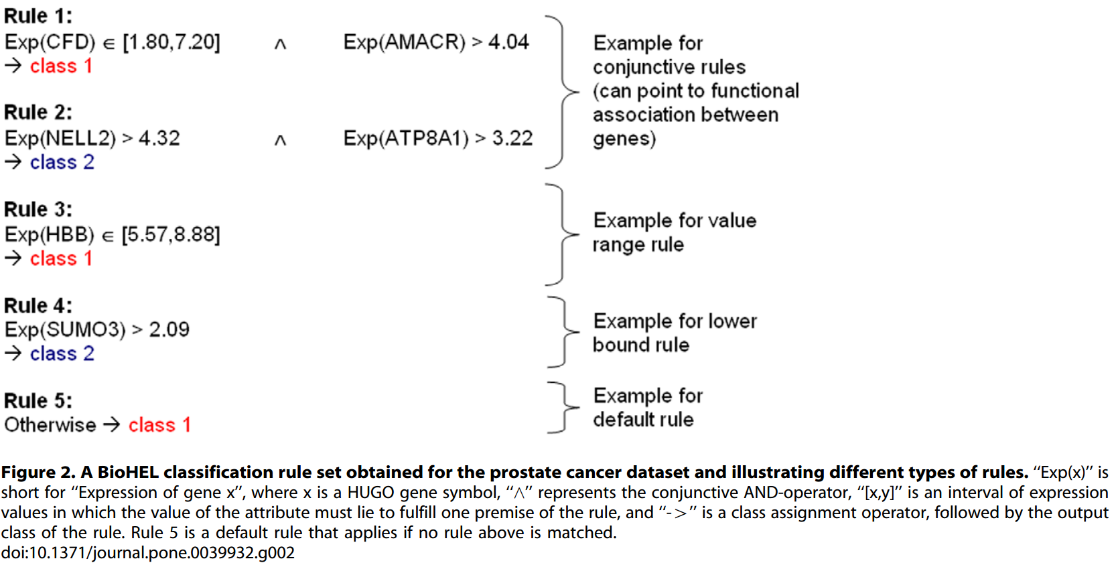
Example of complex rule set: class 1 or class 2?
Hierarchical series of rules
Incorporates conjunctions of value ranges for different variables
Difficult to obtain using conventional statistical methods

Slide 6
Using classical statistical methods for subgroup analysis
Classical statistical methods are occasionally employed post-hoc to identify patient segments associated with treatment response using either bivariate or multivariate methods.
Bivariate approach:
Involves testing many associations for potential significance
I.e. Biomarker A with outcome Y, biomarker B with outcome Y, etc.
Significance levels are corrected for multitesting
E.g. Bonferroni correction
Limitations of this approach include:
Generating false positive findings through multi-testing (type I errors) and over-fitting
Generating false negative findings through not exploring the full set of possible associations
Underpowered analyses due to small cell sizes
Underpowered due to Bonferroni correction

Slide 7
Using classical statistical methods for subgroup analysis (cont)
Multivariate approach:
Involves entering many covariates into a regression model
A subgroup is indicated by a significant treatment-by-covariate interaction term
E.g. Treatment * biomarker A
Limitations of this approach include:
Regression models posit a particular distribution for the data which may not hold
Regressions are prone to experiencing overfitting in the presence of many covariates
I.e. the results will have little validity when applied to new data / patients
This problem is exacerbated where there are many covariates e.g. trials containing biomarker data

Slide 8
Why machine learning is good for subgroup treatment response
Machine learning methods are ideally suited for identifying patient profiles / characteristics predictive of either positive or negative treatment response since the analysis must be able to:
Examine all covariates including combinations
Produce results which are robust where there exists many covariates and relatively few observations
Ensure findings can be generalise
I.e. used by clinicians on ‘real’ patients
Examples of recent studies using machine learning methods to identify patient subgroups for treatment response:
Nassif H, Wu Y, Page D, Burnside E. (2012) Logical Differential Prediction Bayes Net, improving breast cancer diagnosis for older women. AMIA Annu Symp Proc.
Hardin DS et al. (2013) Understanding Heterogeneity in Response to Antidiabetes Treatment: A Post Hoc Analysis Using SIDES, a Subgroup Identification Algorithm Journal of Diabetes Science and Technology

Slide 9
Limitations with machine learning
Limitations of machine learning include:
Many powerful machine learning algorithms are ‘black-box’
Important to use appropriate algorithm if transparency is necessary
Requires highly-skilled data scientists / computer scientists
Hence projects can be expensive
Methods are highly computationally-intensive
Hence timelines for analytical projects can be relatively long
Not appropriate if problem is ‘simple’
E.g. Only handful of variables to analyse
No need to use a sledgehammer to crack a nut
Reserve for complex / challenging projects e.g. post-hoc treatment response profiling

